Slide 1
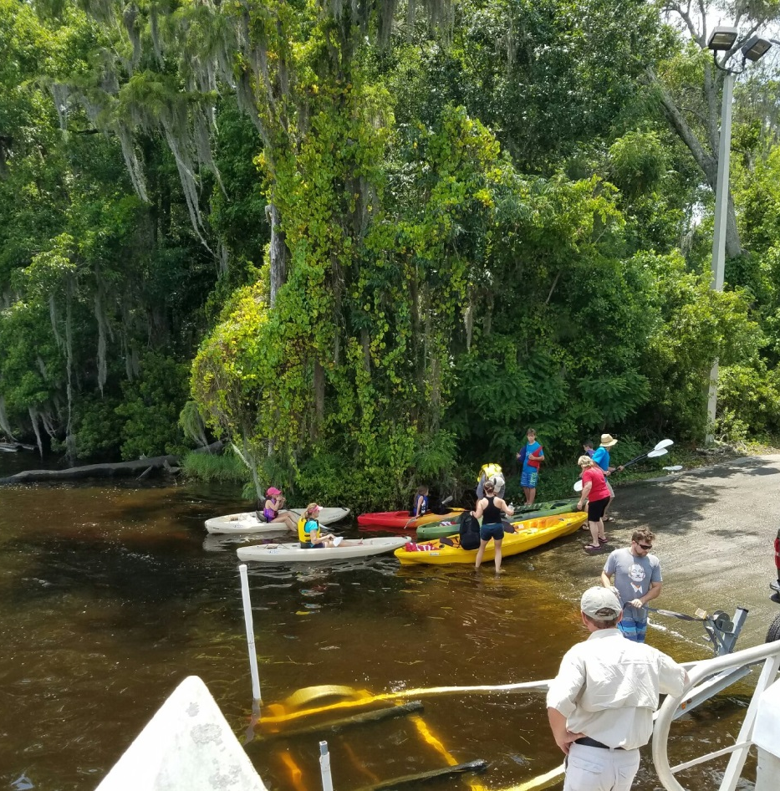
ADAPTIVE PROGRAMMING SUBCOMMITTEE
Jill Haskell, Chair
MANDARIN BOAT RAMP

Slide 2
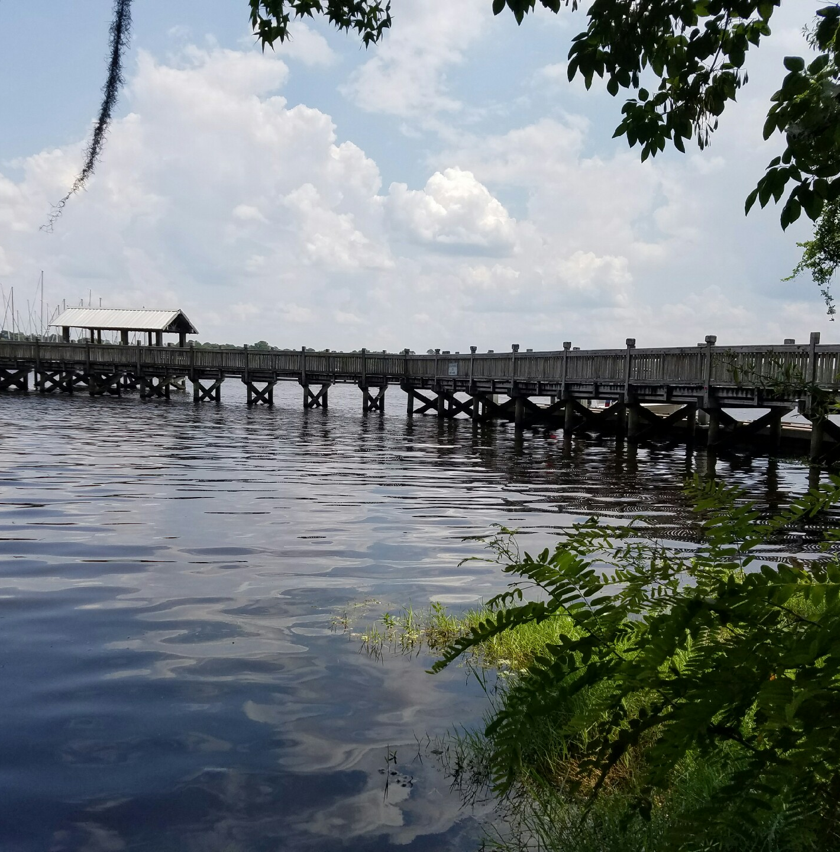
ADAPTIVE PROGRAMMING SUBCOMMITTEE
Jill Haskell, Chair

Slide 3
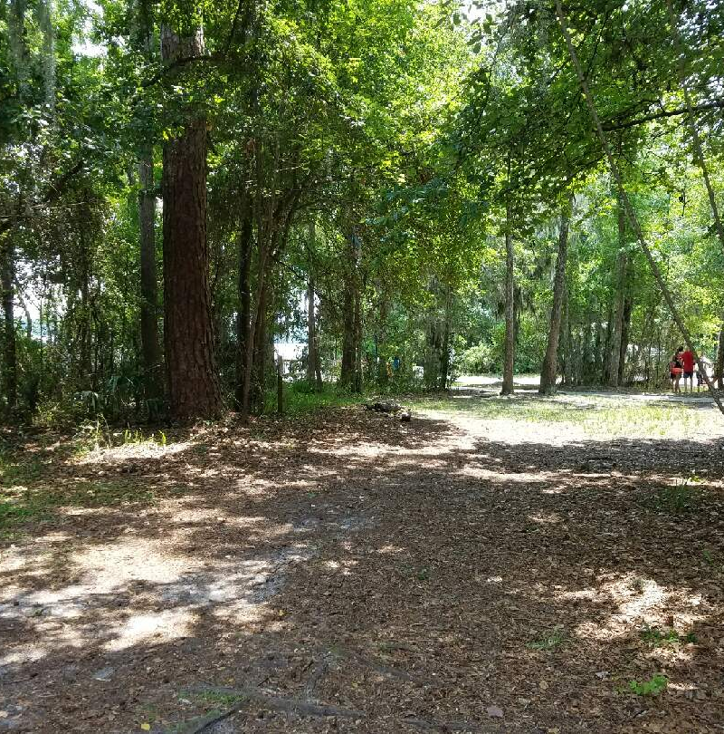
ADAPTIVE PROGRAMMING SUBCOMMITTEE
Jill Haskell, Chair

Slide 4
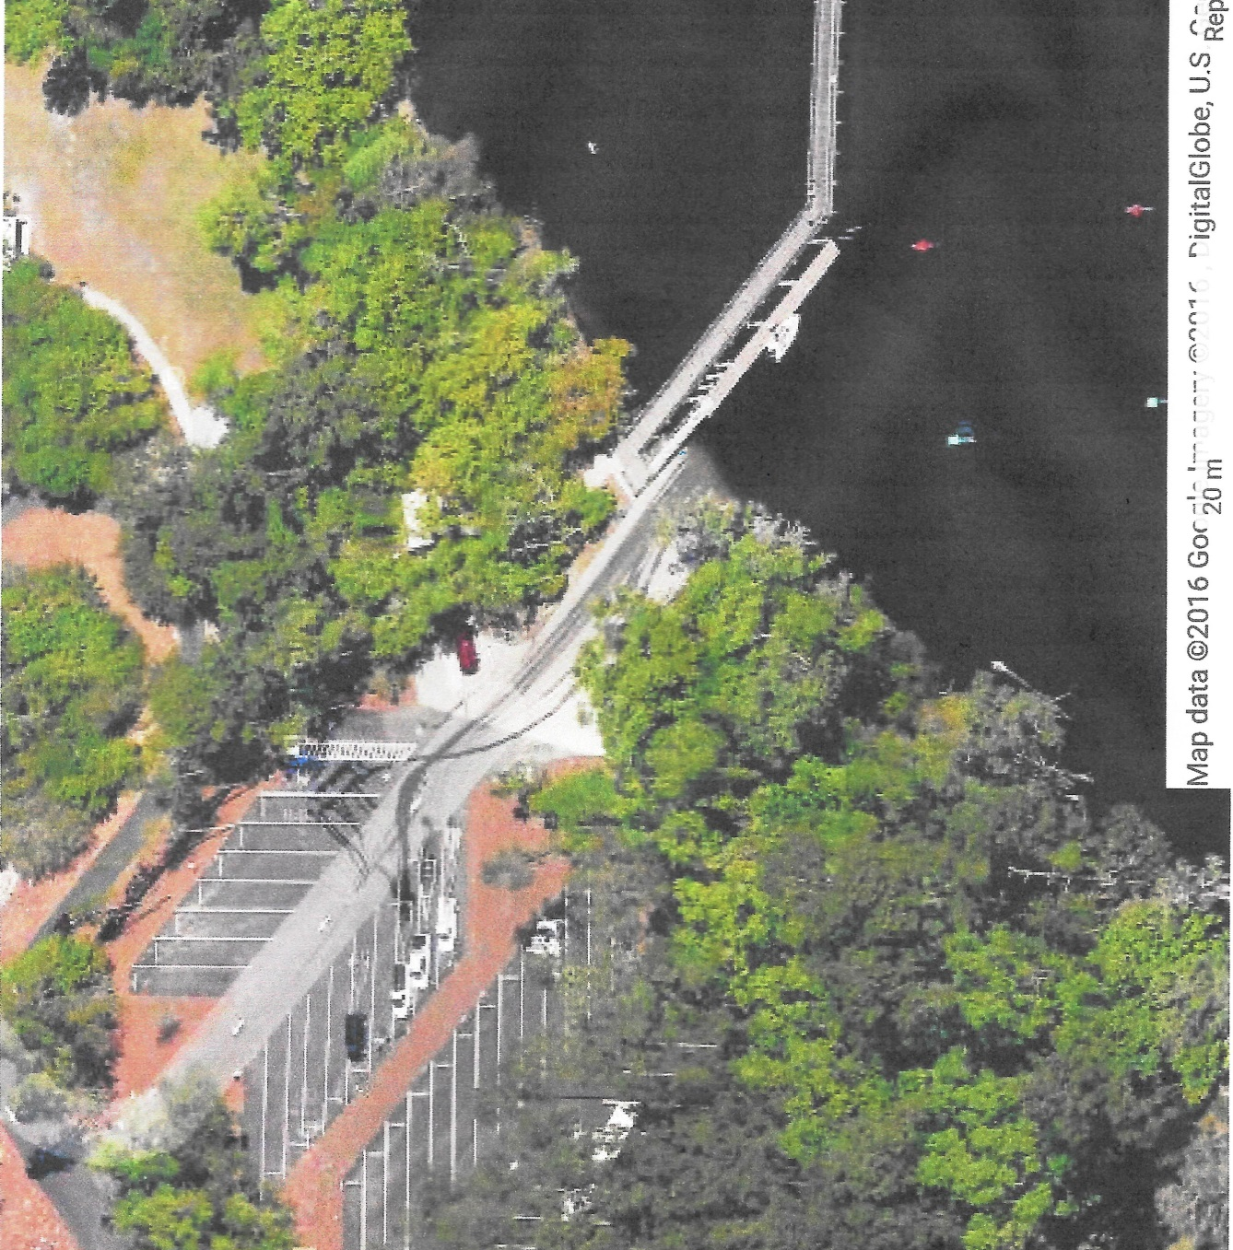
ADAPTIVE PROGRAMMING SUBCOMMITTEE
Jill Haskell, Chair

